Slide 1
Course Objectives
Students successfully completing this course should be able to:
1. To understand the different issues involved in the design and implementation of a database system.
2. To study the physical and logical database designs, database modeling, relational model.
3. To understand and use data manipulation language to query, update, and manage a database.

Slide 2
Course Objectives
4. To develop an understanding of essential DBMS concepts such as: database security, integrity, concurrency, recovery and Data Warehousing.

Slide 3
What is Database?
Database is a collection of related data and data is a collection of facts and figures that can be processed to produce information.
For example, if we have data about marks obtained by all students, we can then conclude about toppers and average marks.

Slide 4
A database has the following properties:
1. Represents some aspect of the real world.
2. It is a logically coherent collection of data with some inherent meaning.
3. A database is design, built, and populated with data for a specific purpose.

Slide 5
DBMS
Database management system is general-purpose software system that is used for the processes of defining, constructing, manipulating, and sharing databases among the users and applications.

Slide 6
Defining a database involves specifying the data types, structures, and constraints for the data to be stored in the database.
Constructing a database is the process of storing data itself on some storage medium.
Manipulating a database involves:
# Query and update the database
# Generate reports
Sharing a database allows multiple users and programs to access the database simultaneously.

Slide 7
# Another important function provided by the DBMS is the protection of database.
# Protection includes both system protection against hardware or software malfunction and security protection against unauthorized or malicious access.

Slide 8
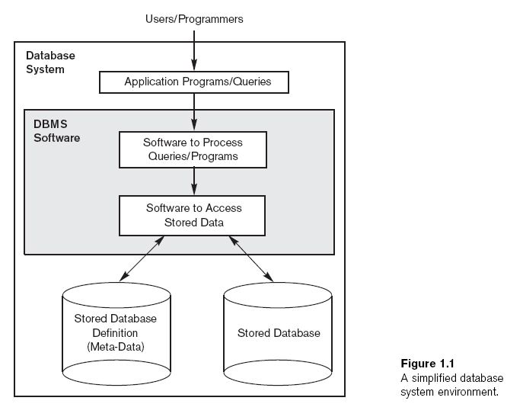

Slide 9
An Example
UNIVERSITY database
  Information concerning students, courses, and grades in a university environment
Data records
  STUDENT
  COURSE
  SECTION
  GRADE_REPORT
  PREREQUISITE

Slide 10
An Example (cont'd.)
Specify structure of records of each file by specifying data type for each data element
  String of alphabetic characters
  Integer
  Etc.

Slide 11
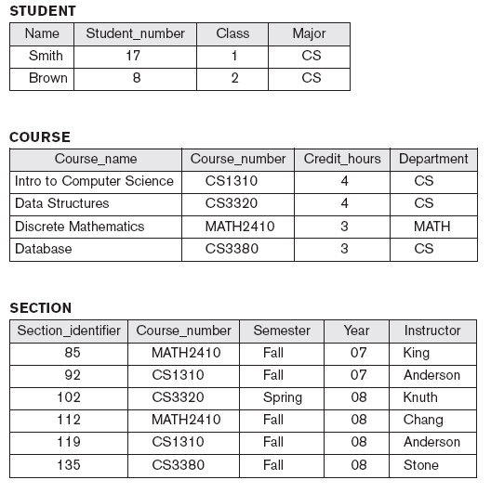
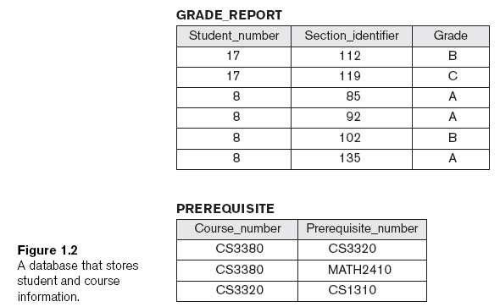

Slide 12
Characteristics of the Database Approach
* Traditional file processing:
Each user defines and implements the files needed for a specific software application
* Database approach:
Single repository maintains data that is defined once and then accessed by various users

Slide 13
Characteristics of the Database Approach (cont'd.)
* Main characteristics of database approach
- Self-describing nature of a database system
- Insulation between programs and data, and data abstraction
- Support of multiple views of the data
- Sharing of data and multiuser transaction processing

Slide 14
Self-Describing Nature of a Database System
* The database system not only contains the database itself but also a complete description of the database structure and constraints.
* This description is stored in DBMS catalog and information stored in catalog is called meta-data.
* This catalog is used by DBMS and users who need information about the database structure.
* In traditional file processing, data definition is a part of the application programs. Hence, these programs are constrained to work with only one specific database, whose structure is declared in the application programs.

Slide 15
Insulation Between Programs and Data
* In file processing, the structure of the data file is embedded in the application program, so any changes to the structure of a file may require changing all application programs that access this file.
* In contrast, DBMS access programs do not require such changes in most cases. The structure of the data file is stored in catalog separately from access programs. We call this program-data independence.

Slide 16
Data Abstraction
* A DBMS provides users with a conceptual representation of data that does not include many details of how the data is stored or how the operation are implemented.
* A data model is a type of data abstraction that is used to provide this conceptual representation.

Slide 17
Support of Multiple Views of the Data
* A database typically has many users, each of whom may require a different perspective or view of the database.
* A view may be a subset of database.
* A multiuser DBMS whose users have a variety of applications must provide facilities for defining multiple views.

Slide 18
Actors on the Scene
* Database administrators (DBA) are responsible for:
  - Authorizing access to the database
- Coordinating and monitoring its use
- Acquiring software and hardware resources
- Accountable for problems such as break of security or poor system response time.

Slide 19
Actors on the Scene
* Database designers are responsible for:
- Identifying the data to be stored
- Choosing appropriate structures to represent and store this data

Slide 20
Actors on the Scene (cont'd.)
* End users:
People whose jobs require access to the database for querying, updating and generating reports.
Types:
Casual users- occasionally access the database, but they may need different information each time. They use sophisticated database query language to specify their requests.
Naive users- make up a sizable portion of database end users. Main function is to query and update the database using standard types of queries and updates.
Sophisticated users- include engineers, scientists and business analysts who thoroughly familiarize themselves with the facilities of the DBMS so as to implement their applications to meet their complex requirements.
Stand-alone users- maintain personal database by using ready-made program packages that provide easy-to-use menu-based or graphics-based interfaces.

Slide 21
Actors on the Scene (cont'd.)
System Analysts- determined the requirements of the end users especially naive users and develop specification for canned transaction that meet these requirements.
Application programmers- implement these specification as programs; then they test, debug, document and maintain these canned transactions. Such analysts and programmers commonly referred to as software engineers.

